Slide 1
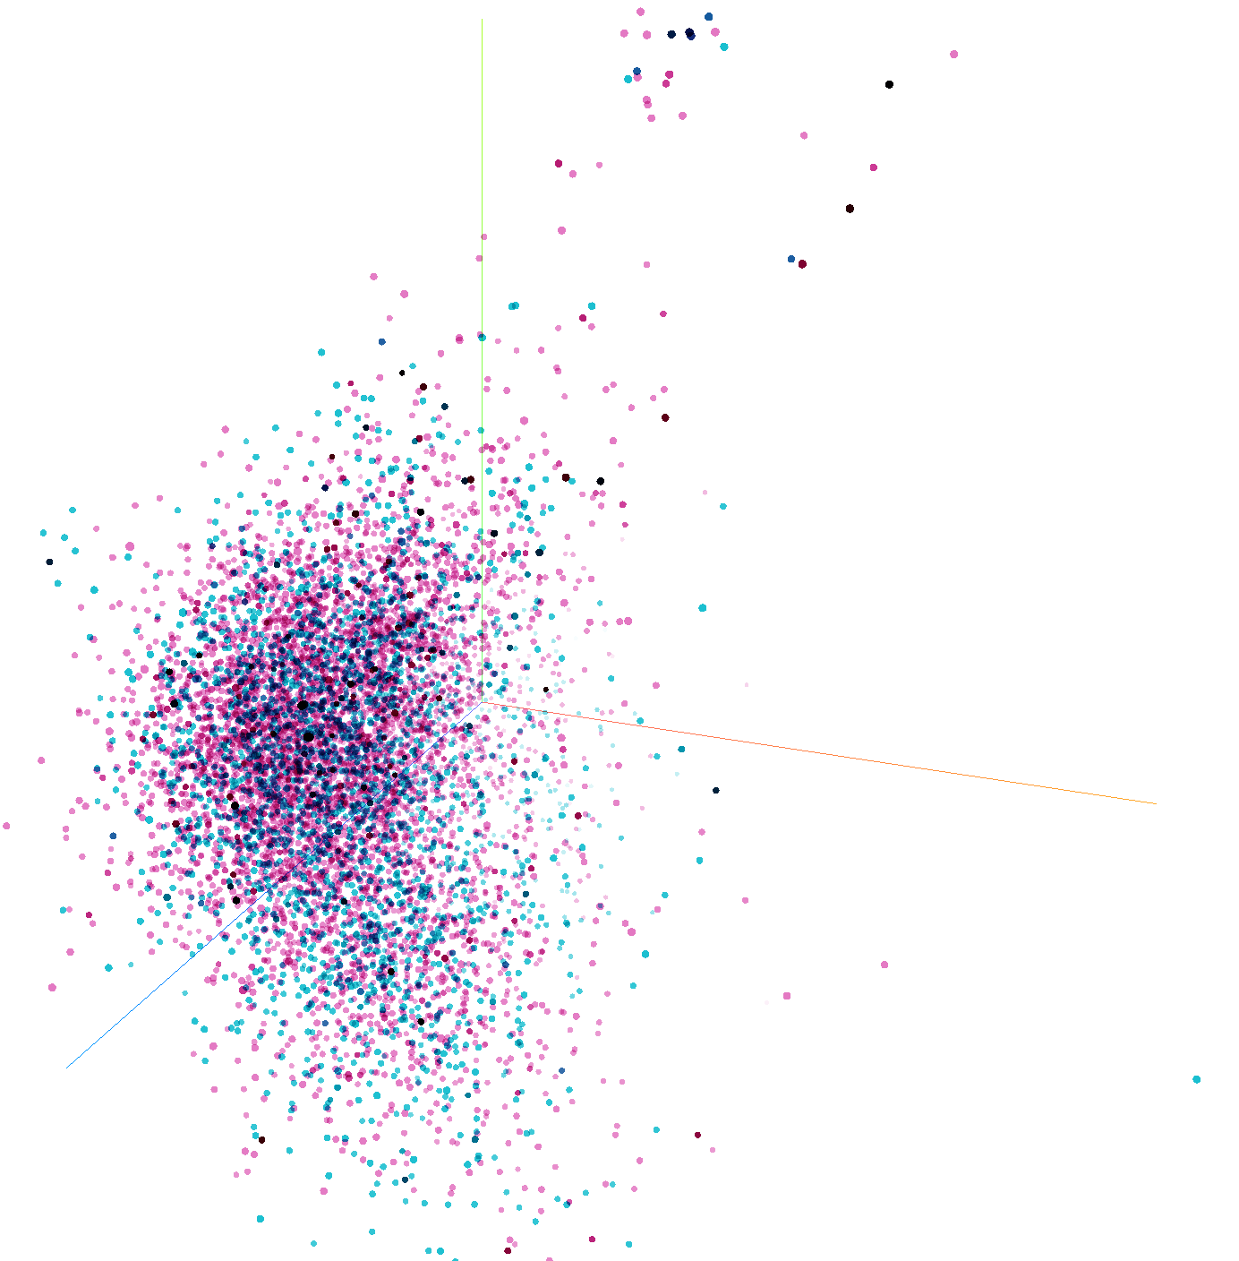
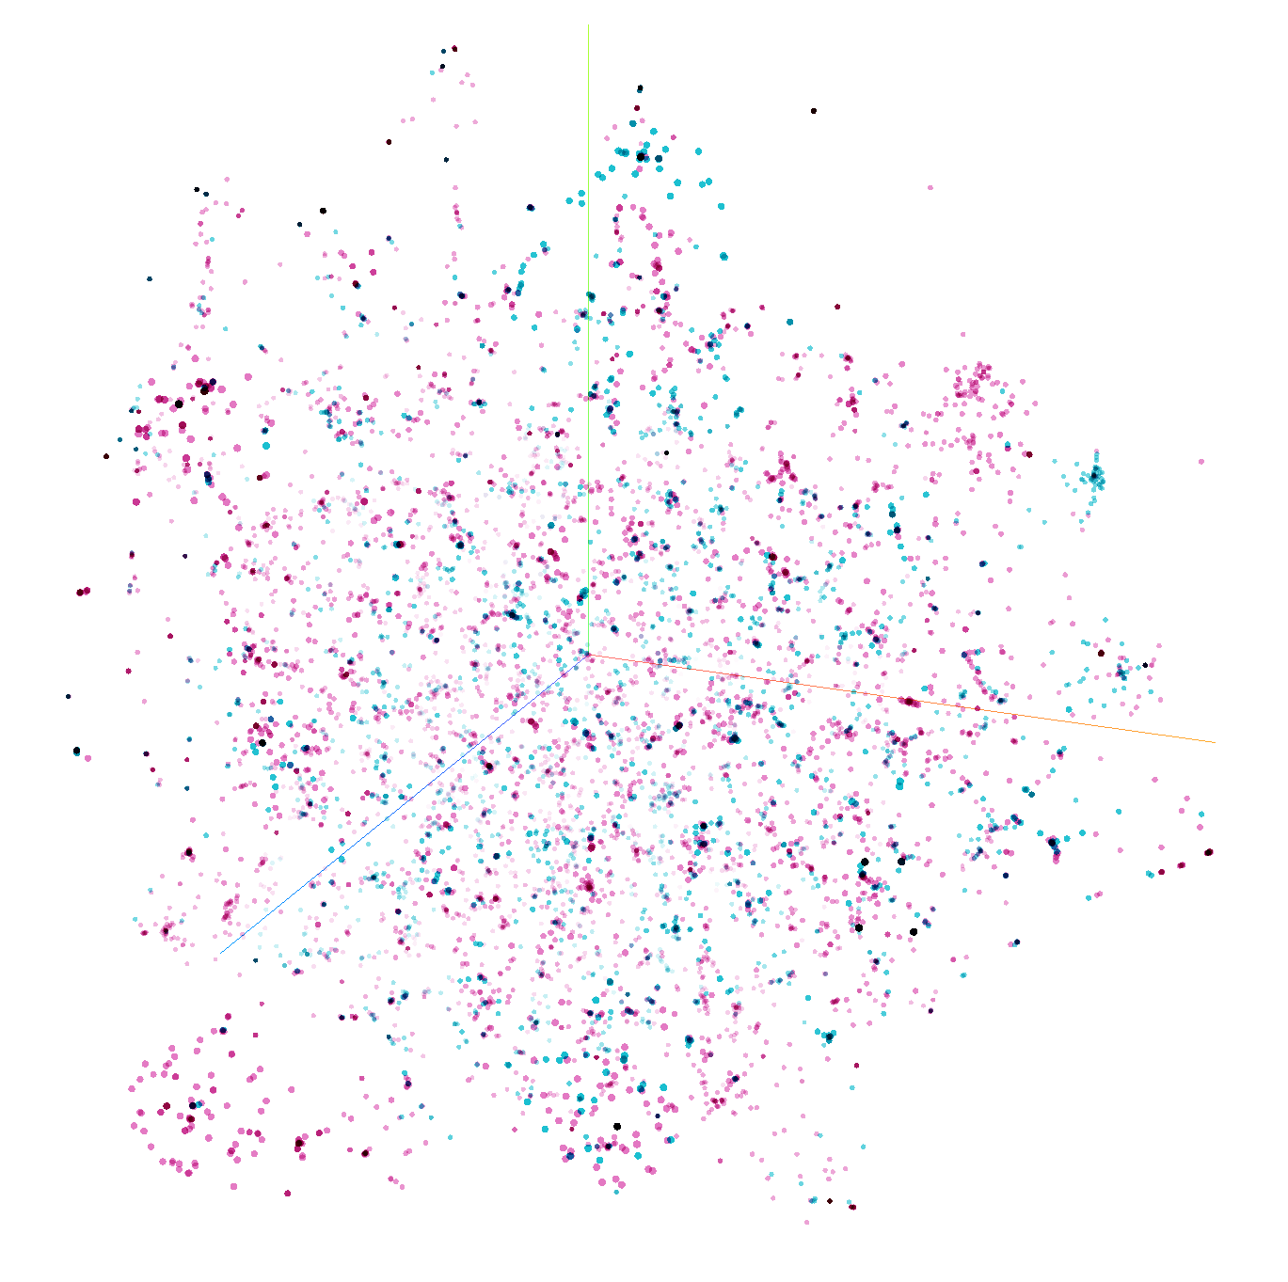
Positive
Negative
(a) PCA
(b) t-SNE

Slide 2
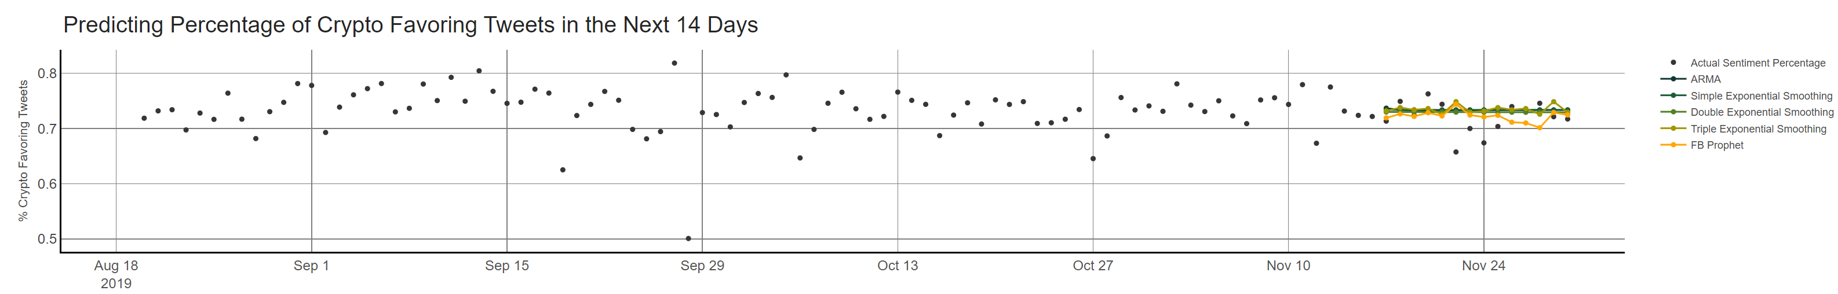
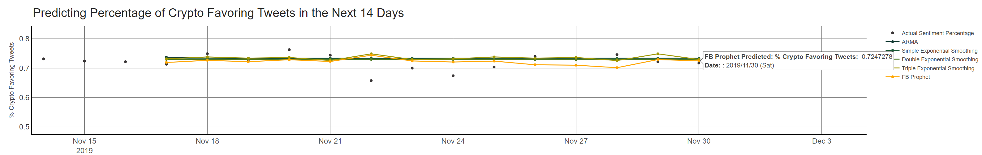
(Zoom-in)

Slide 3
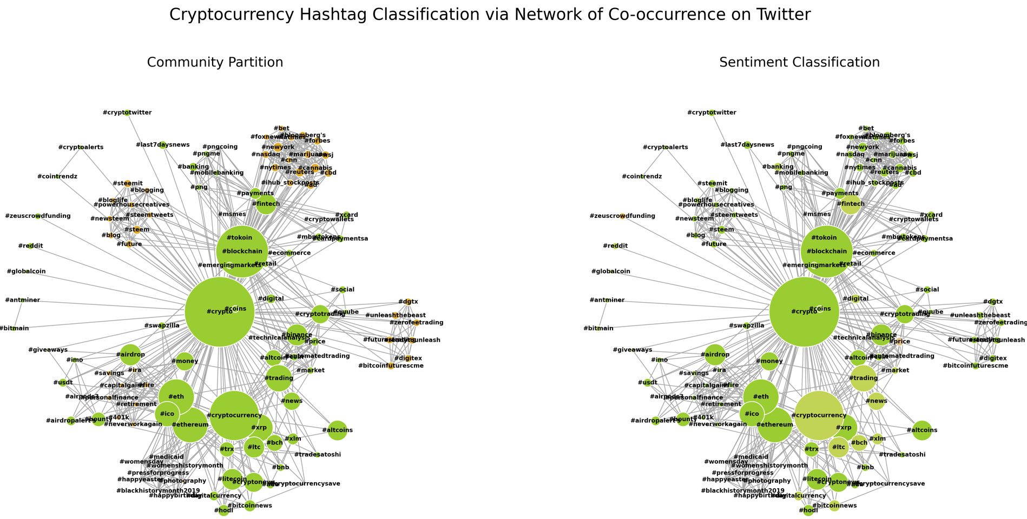

Slide 4
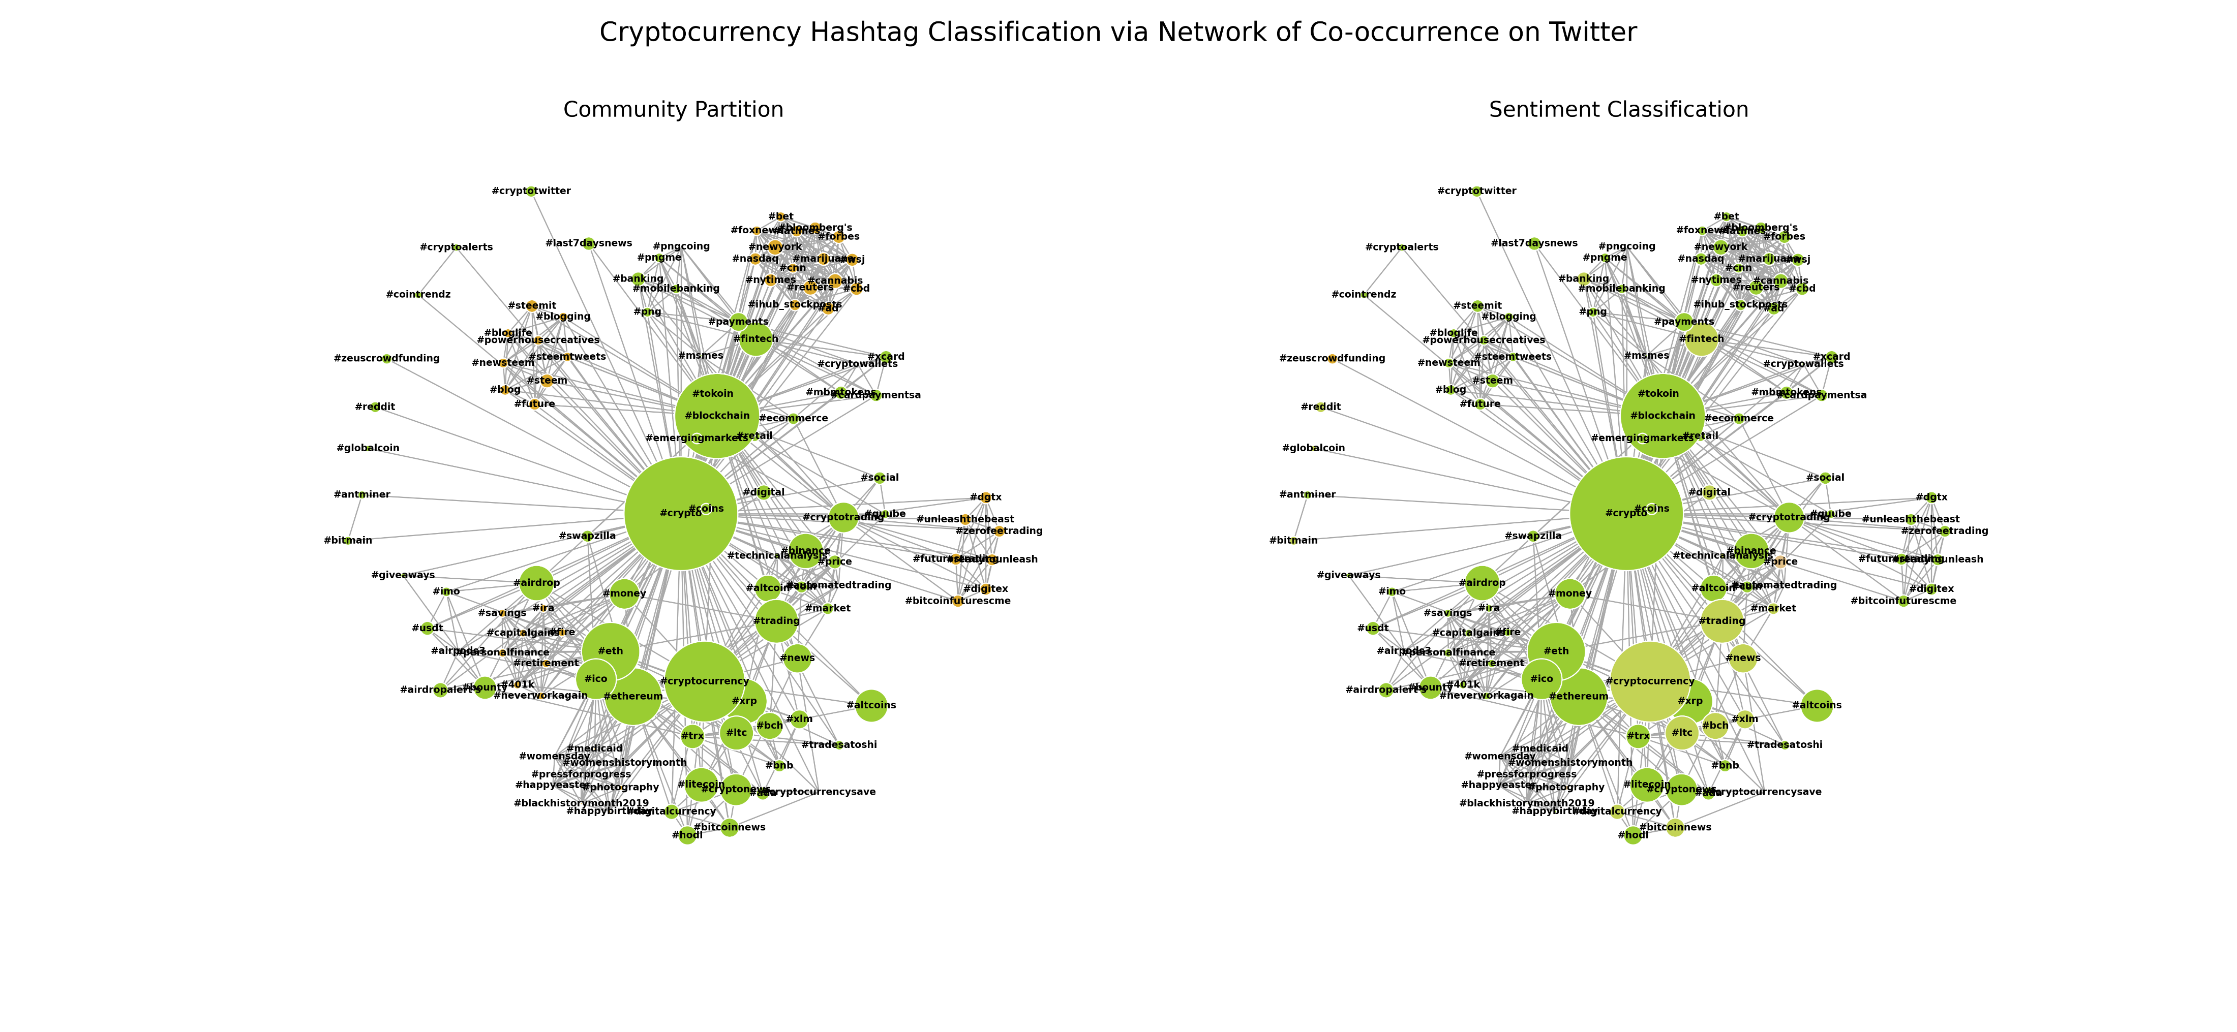

(a) Community Detection: Hashtag Co-occurrence Network
(b) Sentiment Classification: Hashtag Co-occurrence Network
Very Positive
Positive
Community 1
Negative
Community 2
Very Negative

Slide 5
